Slide 1
Module 6 CS 09 Patterns – Part 4 Interactive Systems – MVC/PAC
Harvinder S Jabbal
SSZG653 Software Architectures

Slide 2
Categories
From Mud to Structure.
Patterns in this category help you to avoid a 'sea' of components or objects.
In particular, they support a controlled decomposition of an overall system task into cooperating subtasks.
The category includes
the Layers pattern
the Pipes and Filters pattern
the Blackboard pattern
Distributed Systems.
This category includes one pattern.
Broker
and refers to two patterns in other categories,
Microkernel
Pipes and Filters
The Broker pattern provides a complete infrastructure for distributed applications.
The Microkernel and Pipes and Filters patterns only consider distribution as a secondary concern and are therefore listed under their respective primary categories.
Interactive Systems.
This category comprises two patterns,
the Model-View-Controller pattern (well-known from Smalltalk,)
the Presentation-Abstraction-Control pattern.
Both patterns support the structuring of software systems that feature human-computer interaction.
Adaptable Systems.
This category includes
The Reflection pattern
the Microkernel pattern
strongly support extension of applications and their adaptation to evolving technology and changing functional requirements.

Slide 3
Interactive Systems
This category comprises two patterns,
the Model-View-Controller pattern
(well-known from Smalltalk,)
the Presentation-Abstraction-Control pattern.
Both patterns support the structuring of software systems that feature human-computer interaction.

Slide 4
Interactive Systems

Slide 5
User Interaction
Today's systems allow a high degree of user interaction, mainly achieved with help of graphical user interfaces.
The objective is to enhance the usability of an application.
Usable software systems provide convenient access to their services, and therefore allow users to learn the application and produce results quickly.

Slide 6
user interface
When specifying the architecture of such systems, the challenge is to keep the functional core independent of the user interface.
The core of interactive systems is based on the functional requirements for the system, and usually remains stable.
User interfaces, however, are often subject to change and adaptation.
For example, systems may have to support different user interface standards, customer-specific 'look and feel' metaphors, or interfaces that must be adjusted to fit into a customer's business processes.
This requires architectures that support the adaptation of user interface parts without causing major effects to application-specific functionality or the data model underlying the software.

Slide 7
Model-View-Controller pattern (MVC)
MVC divides an interactive application into three components.
The model contains the core functionality and data.
Views display information to the user.
Controllers handle user input.
Views and controllers together comprise the user interface.
A change-propagation mechanism ensures consistency between the user interface and the model.

Slide 8
The Presentation-Abstraction-Control pattern (PAC)
PAC defines a structure for interactive software systems in the form of a hierarchy of cooperating agents.
Every agent is responsible for a specific aspect of the application's functionality and consists of three components:
presentation,
abstraction, and
control.
This subdivision separates the human-computer interaction aspects of the agent from its functional core and its communication with other agents.

Slide 9
Model-View-Controller

Slide 10
Model-View-Controller
The MVC divides an interactive application into three components.
The model contains the core functionality and data.
Views display information to the user.
Controllers handle user input.
Views and controllers together comprise the user interface.
A change-propagation mechanism ensures consistency between the user interface and the model.

Slide 11
Context
Interactive applications with a flexible human-computer interface.

Slide 12
Problem
User interfaces are especially prone to change requests. When you extend the functionality of an application, you must modify menus to access these new functions.
A customer may call for a specific user interface adaptation, or a system may need to be ported to another platform with a different 'look and feel' standard.
Even upgrading to a new release of your windowing system can imply code changes.
The user interface platform of long-lived systems thus represents a moving target.

Slide 13
Problem
Different users place conflicting requirements on the user interface.
A typist enters information into forms via the keyboard.
A manager wants to use the same system mainly by clicking icons and buttons.
Consequently, support for several user interface paradigms should be easily incorporated.
Building a system with the required flexibility is expensive and error-prone if the user interface is tightly interwoven with the functional core.
This can result in the need to develop and maintain several substantially different software systems, one for each user interface implementation.
Ensuing changes spread over many modules.

Slide 14
Influences
The following forces influence the solution:
The same information is presented differently in different windows, for example, in a bar or pie chart.
The display and behaviour of the application must reflect data manipulations immediately.
Changes to the user interface should be easy, and even possible at run-time.
Supporting different 'look and feel' standards or porting the user interface should not affect code in the core of the application.

Slide 15
Solution
Model-View-Controller (MVC] was first introduced in the Smalltalk-80 programming environment.
MVC divides an interactive application into the three areas:
processing,
output, and
input.

Slide 16
Model
The model component encapsulates core data and functionality.
The model is independent of specific output representations or input behaviour.

Slide 17
View
View components display information to the user. A view obtains the data from the model.
There can be multiple views of the model.

Slide 18
Controller
Each view has an associated controller component.
Controllers receive input, usually as events that encode mouse movement, activation of mouse buttons, or keyboard input.
Events are translated to service requests for the model or the view.
The user interacts with the system solely through controllers.

Slide 19
MVC
The separation of the model from view and controller components allows multiple views of the same model.
If the user changes the model via the controller of one view, all other views dependent on this data should reflect the changes.
The model therefore notifies all views whenever its data changes.
The views in turn retrieve new data from the model and update the displayed information.
This change- propagation mechanism is described in the Publisher-Subscriber pattern

Slide 20
Structure: Model
The model component contains the functional core of the application.
It encapsulates the appropriate data, and exports procedures that perform application-specific processing.
Controllers call these procedures on behalf of the user.
The model also provides functions to access its data that are used by view components to acquire the data to be displayed.
The change-propagation mechanism maintains a registry of the dependent components within the model.
All views and also selected controllers register their need to be informed about changes.
Changes to the state of the model trigger the change-propagation mechanism.
The change-propagation mechanism is the only link between the model and the views and controllers.

Slide 21
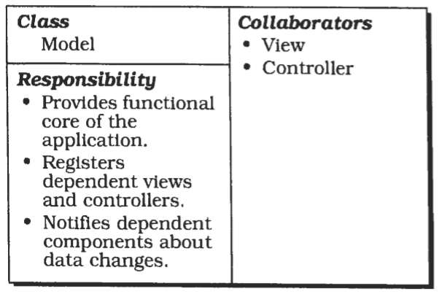
CRC Diagram

Slide 22
Structure: View
View components present information to the user.
Different views present the information of the model in different ways.
Each view defines an update procedure that is activated by the change- propagation mechanism.
When the update procedure is called, a view retrieves the current data values to be displayed from the model, and puts them on the screen.
During initialization all views are associated with the model, and register with the change-propagation mechanism.
Each view creates a suitable controller.
There is a one-to-one relationship between views and controllers.
Views often offer functionality that allows controllers to manipulate the display.
This is useful for user-triggered operations that do not affect the model, such as scrolling.

Slide 23
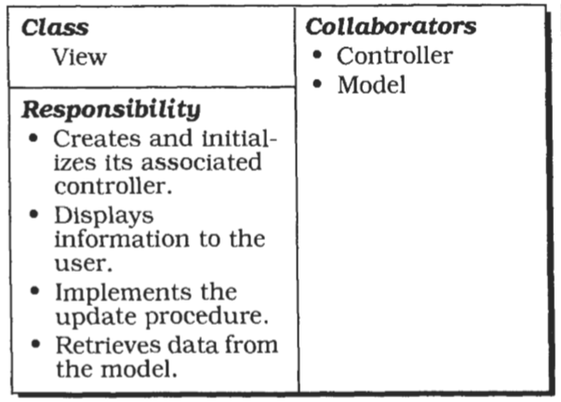
CRC Diagram

Slide 24
Structure: Controller
The controller components accept user input as events.
How these events are delivered to a controller depends on the user interface platform.
For simplicity, let us assume that each controller implements an event-handling procedure that is called for each relevant event.
Events are translated into requests for the model or the associated view.
If the behaviour of a controller depends on the state of the model, the controller registers itself with the change-propagation mechanism and implements an update procedure.
For example, this is necessary when a change to the model enables or disables a menu entry.

Slide 25
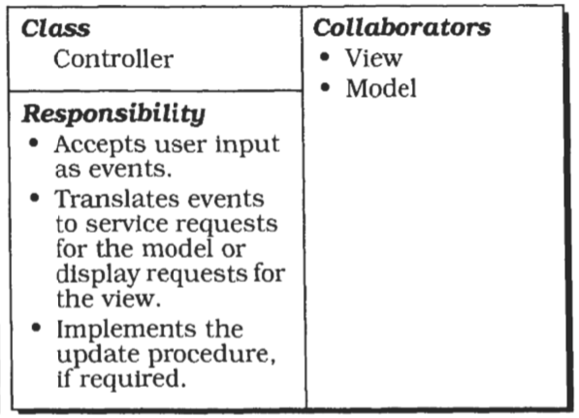
CRC Diagram

Slide 26
Popular Structural Variations
Object Oriented
implementation of MVC would define a separate class for each component
C++
view and controller classes share a common parent that defines the update interface.
Smalltalk.
the class Object dehes methods for both sides of the change- propagation mechanism.
A separate class Observer is not needed.

Slide 27
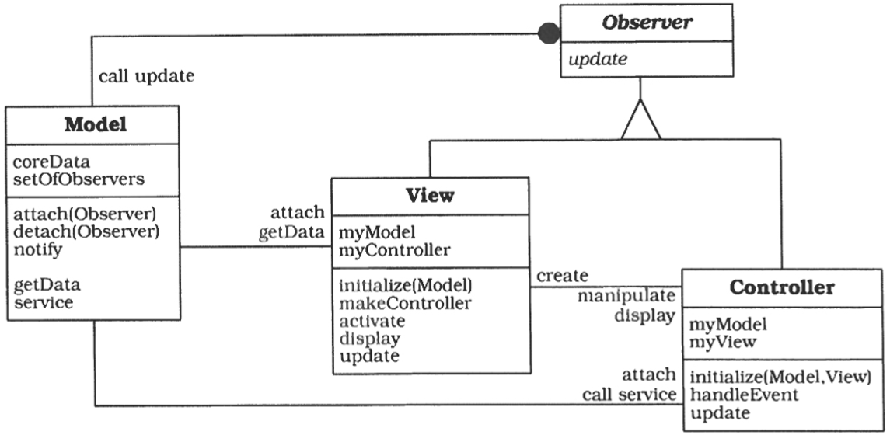
Structure: C++

Slide 28
Implementation
Separate human-computer interactionfrom corefunctionality
Implement the change-propagationm echanism
Design and implement the views
Design and implement the controllers
Design and implement the view-controller relationship
Implement the set-up of MVC
Dynamic view creation
'Pluggable controllers
Infrastructure for hierarchical views and controllers
Further decoupling from system dependencies

Slide 29
Variants
Document-View
This variant relaxes the separation of view and controller.
In several GUI platforms, window display and event handling are closely interwoven.
For example, the X Window System reports events relative to a window.
You can combine the responsibilities of the view and the controller from MVC in a single component by sacrificing exchangeability of controllers.

Slide 30
Known Usages
Smalltalk
The VisualWorks Smalltalk environment supports different 'look and feel' standards by decoupling view and controllers via display and sensor classes
MFC (Microsoft Foundation Class Library)
The Document-View variant of the Model-View- Controller pattern is integrated in the Visual C++ environment
ET++
Establishes 'look and feel' independence by defining a class Window port that encapsulates the user interface platform dependencies, in the same way as do our display and sensor classes. Uses document-view variant.

Slide 31
Consequences: Benefits
Multiple views of the same model
Synchronized views.
'Pluggable' views and controllers.
Exchangeability of 'look and feel’.
Framework Potential.

Slide 32
Consequences: Liabilities
Increased complexity.
Potential for excessive number of updates.
Intimate connection between view and controller.
Close coupling of views and controllers to a model.
Inefficiency of data access in view.
Inevitability of change to view and controller when porting.
Difficulty of using MVC with modern user-interface took.

Slide 33
PAC: Presentation-Abstraction-Control

Slide 34
Presentation-Abstraction-Control
The Presentation-Abstraction-Control architectural pattern (PAC) defines a structure for interactive software systems in the form of a hierarchy of cooperating agents.
Every agent is responsible for a specific aspect of the application's functionality and consists of three components: presentation, abstraction, and control.
This subdivision separates the human-computer interaction aspects of the agent from its functional core and its communication with other agents

Slide 35
Context
Development of an interactive application with the help of agents.
In the context of this pattern an agent denotes an information-processing component that includes event receivers and transmitters, data structures to maintain stale, and a processor that handles incoming events, updates its own state, and that may produce new events.
Agents can be as small as a single object, but also as complex as a complete software system.
We use the terms agent and PAC agent as synonyms in this pattern description

Slide 36
Problem
Interactive systems can often be viewed as a set of cooperating agents.
Agents specialized in human-computer interaction accept user input and display data.
Other agents maintain the data model of the system and offer functionality that operates on this data.
Additional agents are responsible for diverse tasks such as error handling or communication with other software systems.
Besides this horizontal decomposition of system functionality, we often encounter a vertical decomposition.

Slide 37
Example
Production planning systems (PPS) , for example, distinguish between production planning and the execution of a previously specified production plan.
For each of these tasks separate agents can be defined.
In such an architecture of cooperating agents, each agent is specialized for a specific task, and all agents together provide the system functionality.
This architecture also captures both a horizontal and vertical decomposition.

Slide 38
Forces
Agents often maintain their own state and data.
For example, in a PPS system, the production planning and the actual production control may work on different data models, one tuned for planning and simulation and one performance-optimized for efficient production.
However, individual agents must effectively cooperate to provide the overall task of the application.
To achieve this, they need a mechanism for exchanging, data, messages, and events.
Interactive agents provide their own user interface, since their respective human-computer interactions often differ widely.
For example, entering data into spreadsheets is done using keyboard input, while the manipulation of graphical objects uses a pointing device.
Systems evolve over time.
Their presentation aspect is particularly prone to change.
The use of graphics, and more recently, multi-media features, are examples of pervasive changes to user interfaces.
Changes to individual agents, or the extension of the system with new agents, should not affect the whole system.

Slide 39
Solution
Structure the interactive application as a tree-like hierarchy of PAC agents.
There should be one top-level agent, several intermediate-level agents, and even more bottom-level agents.
Every agent is responsible for a specific aspect of the application's functionality, and consists of three components: presentation, abstraction, and control.
The whole hierarchy reflects transitive dependencies between agents.
Each agent depends on all higher-level agents up the hierarchy to the top-level agent.

Slide 40
Agents
The agent's presentation component provides the visible behaviour of the PAC agent.
Its abstraction component maintains the data model that underlies the agent, and provides functionality that operates on this data.
Its control component connects the presentation and abstraction components, and provides functionality that allows the agent to communicate with other PAC agents.

Slide 41
The top-level PAC agent
The top-level PAC agent provides the functional core of the system.
Most other PAC agents depend or operate on this core. Furthermore, the top-level PAC agent includes those parts of the user interface that cannot be assigned to particular subtasks, such as menu bars or a dialog box displaying information about the application.

Slide 42
Bottom-level PAC agents
Bottom-level PAC agents represent self-contained semantic concepts on which users of the system can act, such as spreadsheets and charts.
The bottom-level agents present these concepts to the user and support all operations that users can perform on these agents, such as zooming or moving a chart.

Slide 43
Intermediate-level PAC agents
Intermediate-level PAC agents represent either combinations of, or relationships between, lower-level agents.
For example, an intermediate-level agent may maintain several views of the same data, such as a floor plan and an external view of a house in a CAD system for architecture.

Slide 44
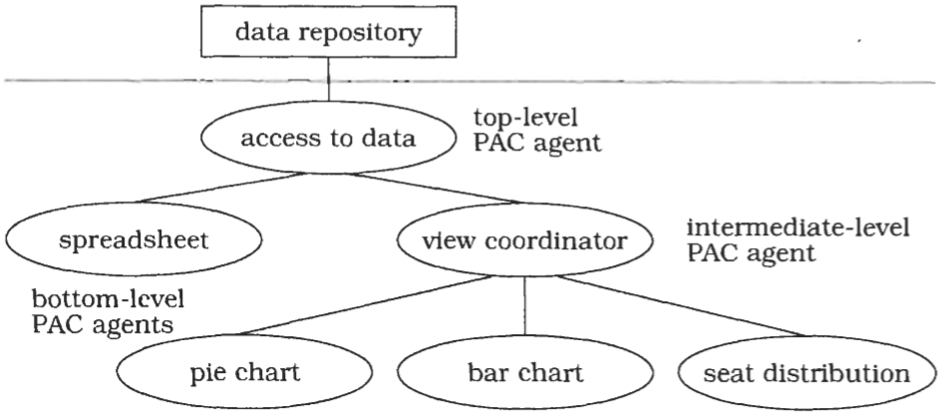
Typical Hierarchy of Agents

Slide 45
Structure: Top Level Agent
(component)
The main responsibility of the top-level PAC agent is to provide the global data model of the software.
This is maintained in the abstraction component of the top-level agent.
The interface of the abstraction component offers functions to manipulate the data model and to retrieve information about it.
The representation of data within the abstraction component is media-independent.
For example, in a CAD system for architecture, walls, doors, and windows are represented in centimetres or inches that reflect their real size, not in pixels for display purposes.
This media-independency supports adaptation of the PAC agent to different environments without major changes in its abstraction component.

Slide 46
Structure: Top Level Agent
(presentation)
The presentation component of the top-level agent often has few responsibilities.
It may include user-interface elements common to the whole application.
In some systems, such as the network traffic manager, there is no top-level presentation component at all.

Slide 47
Structure: Top Level Agent
(control)
The control component of the top-level PAC agent has three responsibilities:
1
It allows lower-level agents to make use of the services of the top-level agents, mostly to access and manipulate the global data model.
Incoming service requests from lower-level agents are forwarded either to the abstraction component or the presentation component.
2
It coordinates the hierarchy of PAC agents.
It maintains information about connections between the top-level agent and lower-level agents.
The control component uses this information to ensure correct collaboration and data exchange between the top-level agent and lower-level agents.
3
It maintains information about the interaction of the user with the system.
For example, it may check whether a particular operation can be performed on the data model when triggered by the user.
It may also keep track of the functions called to provide history or undo/redo services for operations on the functional core.

Slide 48
Bottom Level Agent
Bottom-level PAC agents represent a specific semantic concept of the application domain, such as a mailbox in a network traffic management system or a wall in a mobile robot system.
This semantic concept may be as low-level as a simple graphical object such as a circle, or as complex as a bar chart that summarizes all the data in the system.

Slide 49
Bottom Level Agent
(presentation)
The presentation component of a bottom-level PAC agent presents a specific view of the corresponding semantic concept, and provides access to all the functions users can apply to it.
Internally, the presentation component also maintains information about the view, such as its position on the screen.

Slide 50
Bottom Level Agent
(abstraction)
The abstraction component of a bottom-level PAC agent has a similar responsibility as the abstraction component of the top-level PAC agent, maintaining agent-specific data.
In contrast to the abstraction component of the top-level agent, however, no other PAC agents depend on this data.

Slide 51
Bottom Level Agent
(control)
The control component of a bottom-level PAC agent maintains consistency between the abstraction and presentation components, thereby avoiding direct dependencies between them.
It serves as an adapter and performs both interface and data adaptation.
The control component of bottom-level PAC agents communicates with higher-level agents to exchange events and data.
Incoming events-such as a 'close window' request-are forwarded to the presentation component of the bottom-level agent, while incoming data is forwarded to its abstraction component.
Outgoing events and data, for example error messages, are sent to the associated higher-level agent.

Slide 52
Bottom Level Agent
Concepts represented by bottom-level PAC agents, such as the bar and pie charts in the example, are atomic in the sense that they are the smallest units a user can manipulate. The users can only operate on the bar chart as a whole, for instance by changing the scaling factor of the y-axis. They cannot, for example, resize an individual bar of a bar chart.
Bottom-level PAC agents are not restricted to providing semantic concepts of the application domain. You can also specify bottom-level agents that implement system services.
For example, there may be a communication agent that allows the system to cooperate with other applications and to monitor this cooperation

Slide 53
Intermediate-Level PAC agents
(composition)
Intermediate-Level PAC agents can fulfil two different roles:
composition and coordination
When, for example, each object in a complex graphic is represented by a separate PAC agent, an intermediate-level agent groups these objects to form a composite graphical object.
The intermediate-level agent defines a new abstraction, whose behaviour encompasses both the behaviour of its components and the new characteristics that are added to the composite object.

Slide 54
Intermediate-Level PAC agents
(coordination)
The second role of an intermediate-level agent is to maintain consistency between lower- level agents, for example when coordinating multiple views of the same data.
The abstraction component maintains the specific data of the intermediate-level PAC agent. The presentation component implements its user interface. The control component has the same responsibilities of the control components of bottom-level PAC agents and of the top- level PAC agent.

Slide 55
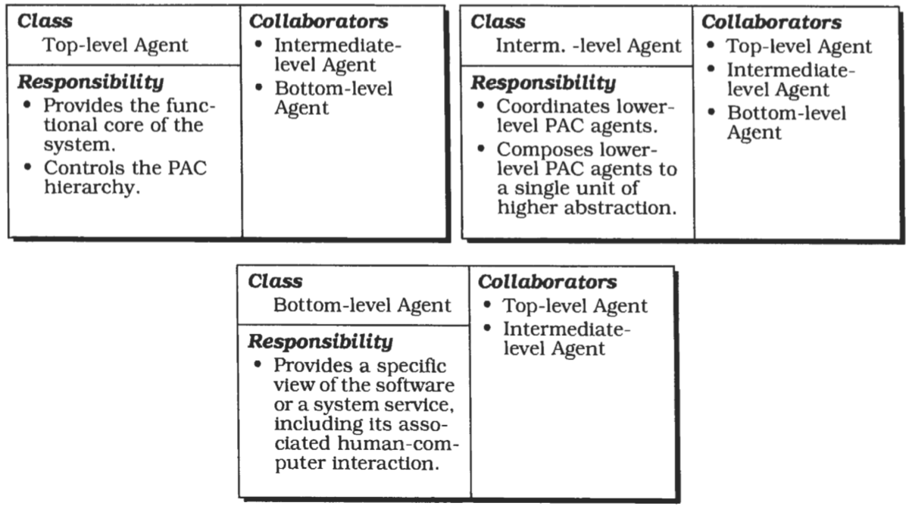
CRC Diagrams

Slide 56
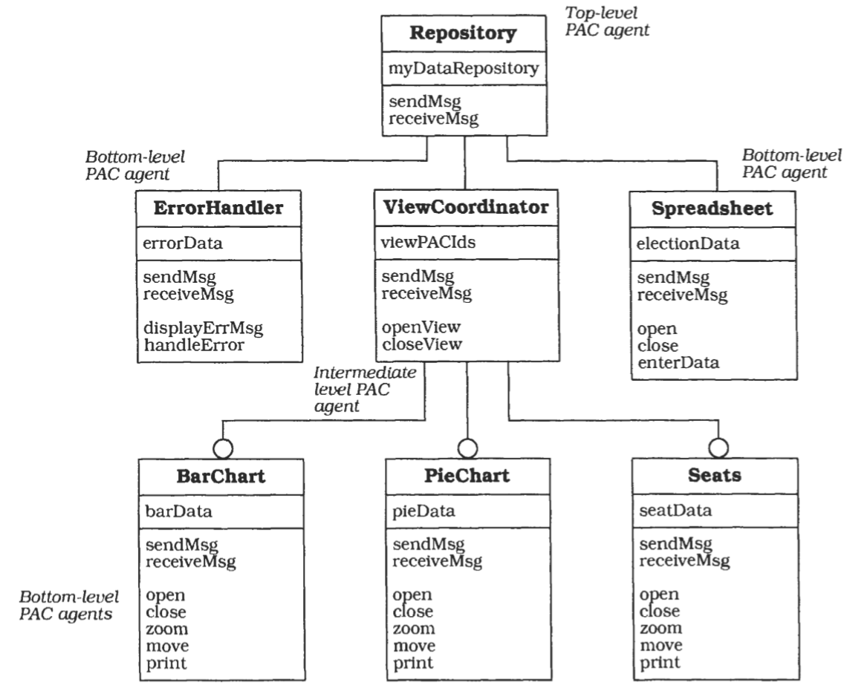
Typical PAC Object Model

Slide 57
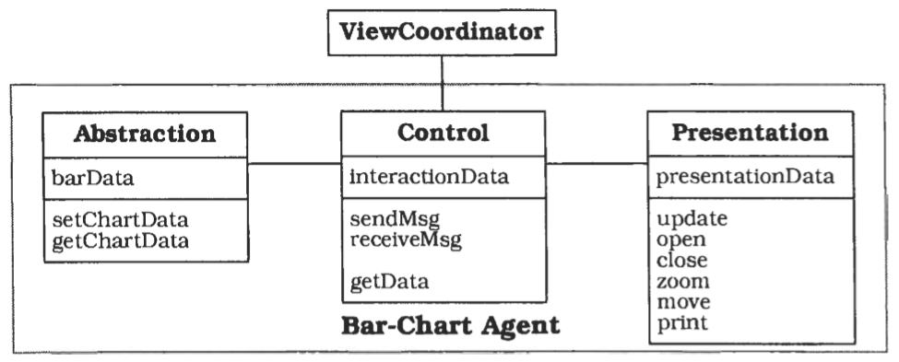
Internal Structure of a PAC Agent

Slide 58
Implementation
Define a model of the application.
Define a general strategy for organizing the PAC hierarchy
Specify the top-level PAC agent.
Specify the bottom-level PAC agents
Specih bottom-level PAC agents for system services.
Specify intermediate-level PAC agents to compose lower-level PAC agents
Specify intermediate-level PAC agents to coordinate lower-level PAC agents.
Separate core functionality from human-computer interaction
Provide the external interface.

Slide 59
Variants
Many large applications-especially interactive ones-are multi-user systems. Multi-tasking is thus a major concern when designing such software systems.
Variants
PAC agents as active objects
PAC agents as processes.

Slide 60
Known Usages
Network Traffic Management.
Mobile Robot.

Slide 61
Consequences: benefits
Separation of concerns
Support for change and extension
Support for multi-tasking

Slide 62
Consequences: Liabilities
Increased system complexity.
Complex control component
Applicability.

Slide 63
Thank you
The END

